Slide 1
DRC Workshop 2:
OpenCV Continued...
CREATE
18/03/2020
Notes:
https://www.google.com/url?sa=i&source=images&cd=&cad=rja&uact=8&ved=2ahUKEwihrI_usuLlAhXOe30KHc7eBWcQjhx6BAgBEAI&url=https%3A%2F%2Fwww.redbubble.com%2Fpeople%2Fentrfacts%2Fworks%2F28524375-dabbing-skeleton-dab-skull-rainbow-funny-halloween-hip-hop-pose%3Fp%3Dipad-case&psig=AOvVaw0xLquUYUgx41BdwPbd5I51&ust=1573569906472128

Slide 2
Get the file from:
https://github.com/3rsw/DRC_workshops

Slide 3
Pseudocode
find_contour()
find the center of the largest contour
draw_center()
find the center of two tuples
capture the video from a file
define upper and lower thresholds
while(1)
apply masks
find center of contours
find the center of the two contours
end the loop if q is pressed
Release resources

Slide 4
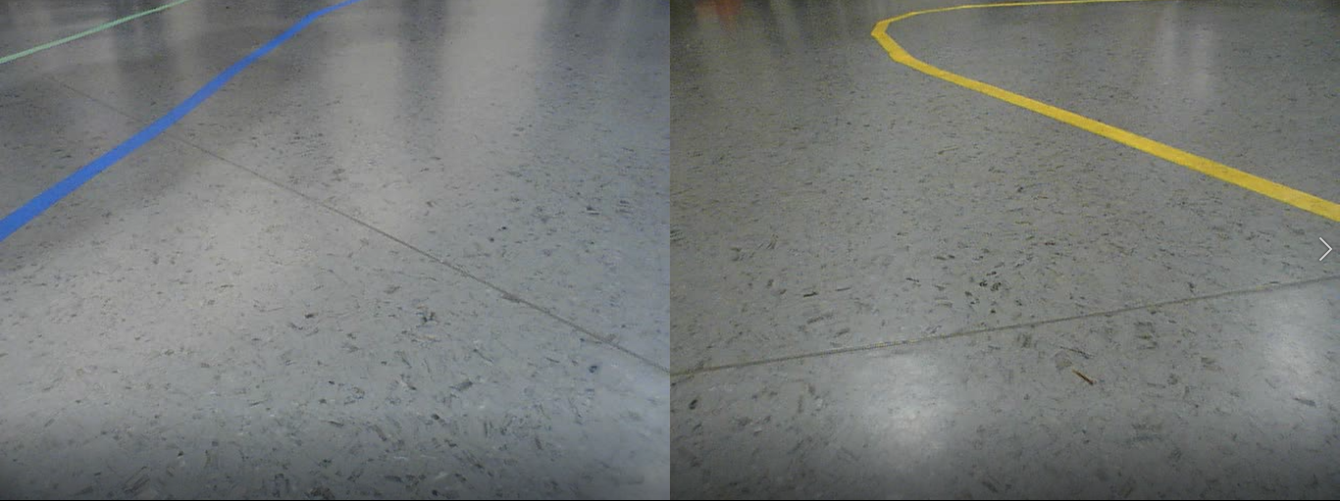
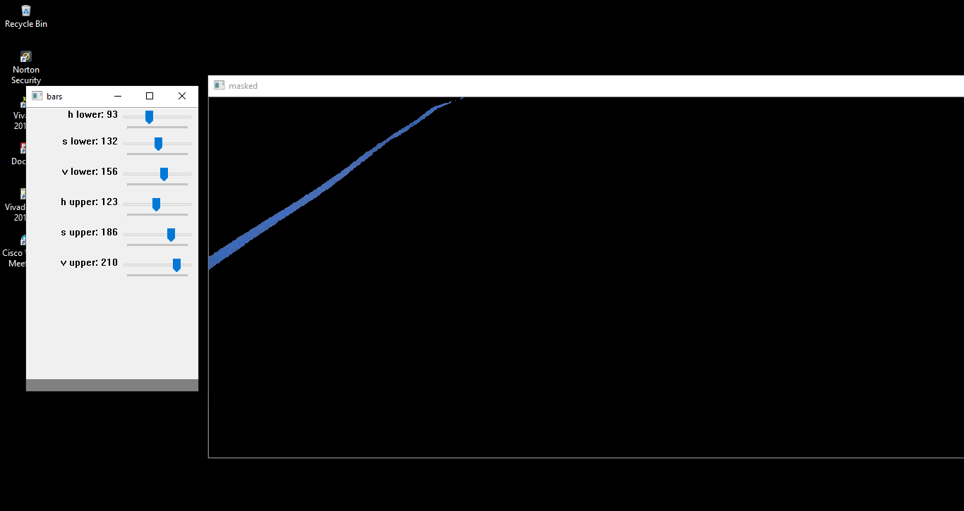
Using last week’s code:
Take a screenshot
Change from reading a video to reading from an image (look up cv2.imread())
Record the HSV upper and lower thresholds for the blue and yellow line

Slide 5
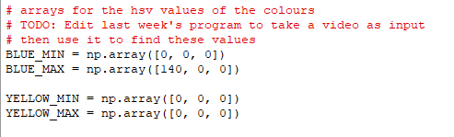
Add your HSV thresholds

Slide 6
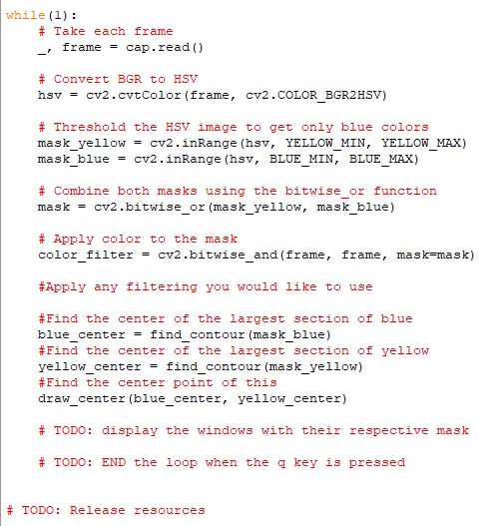
Complete the missing lines in the main function (look at last week’s code if you get stuck
Release the resources

Slide 7
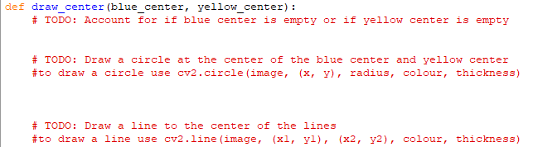
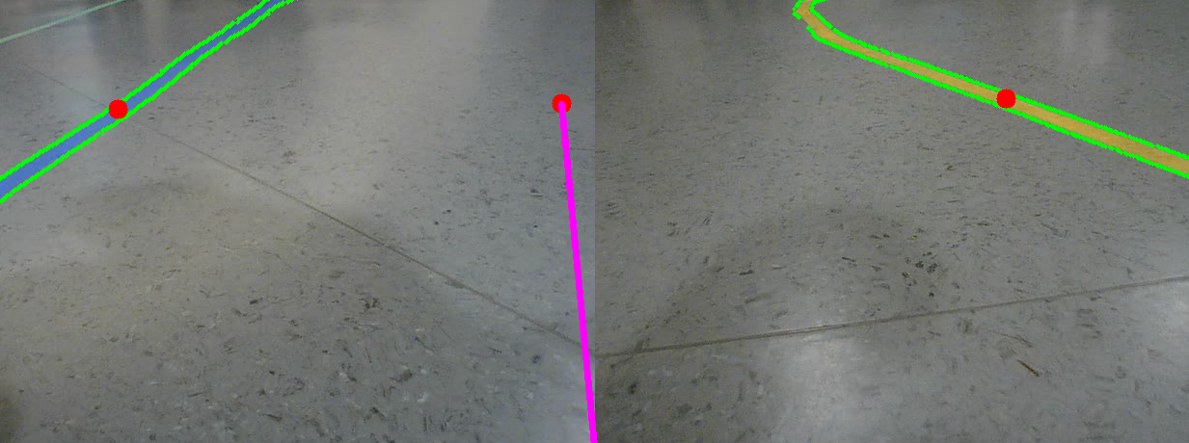
Given a tuple representing the blue center and yellow center find the center
Place a dot at the center
Draw a line from the bottom center to that dot and draw a line to it

Slide 8
After Dan’s talk add in some filtering such as:
-Dilation
-Canny edge
-Hough line transform

